Slide 1
910 nm r-CBG Charatecterization

Slide 2
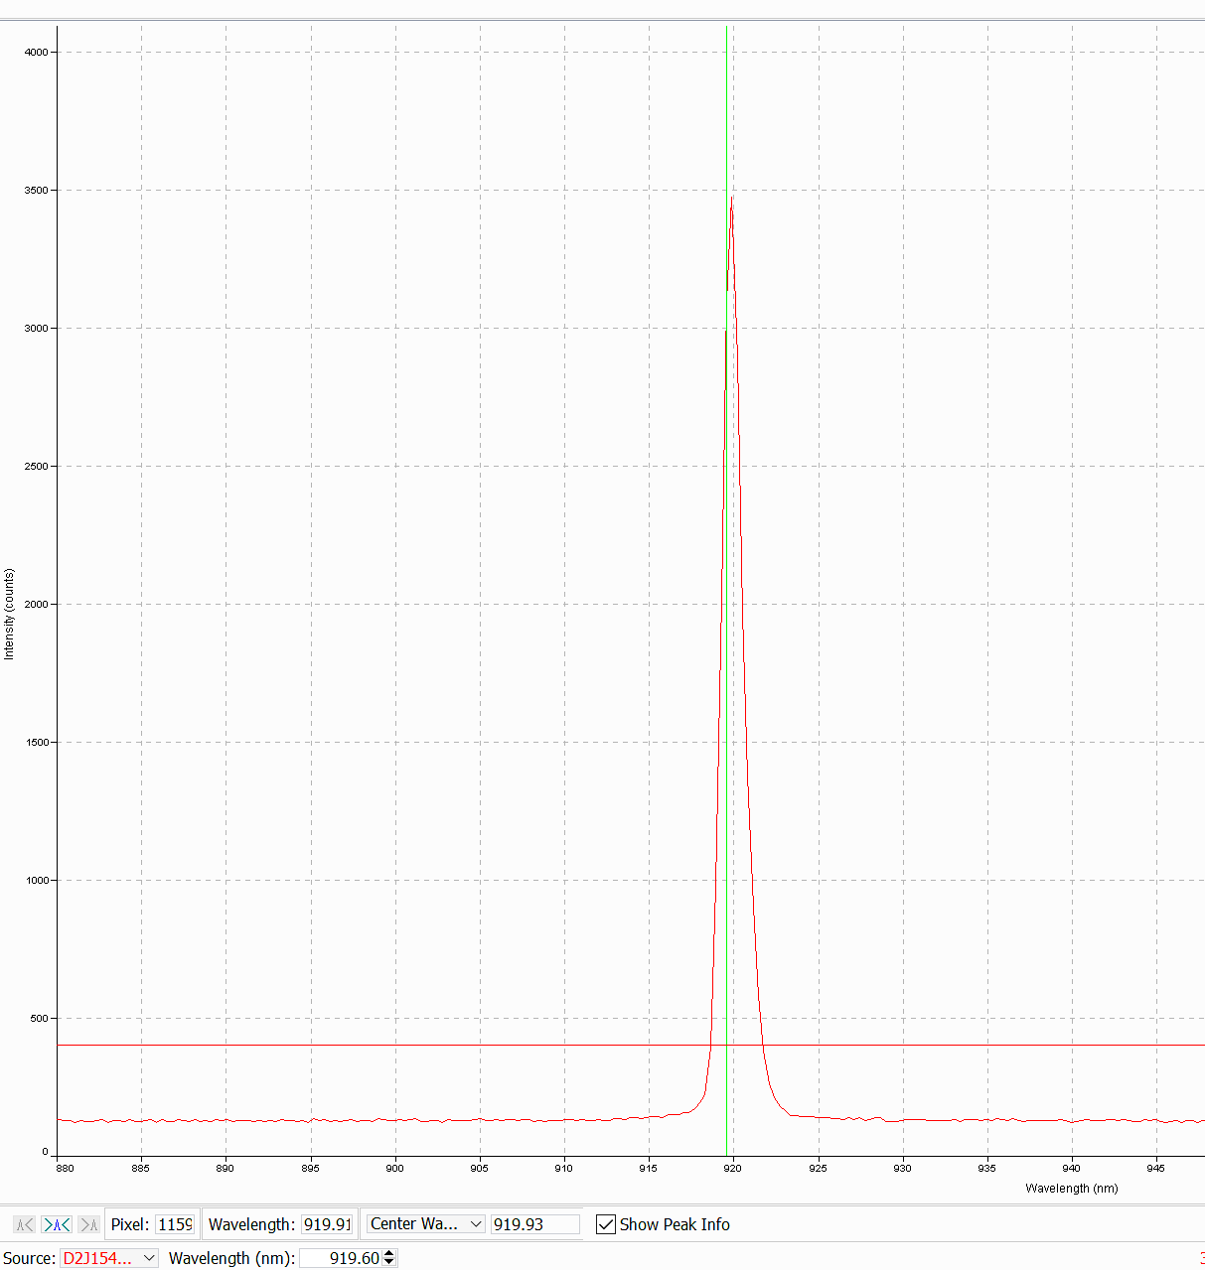
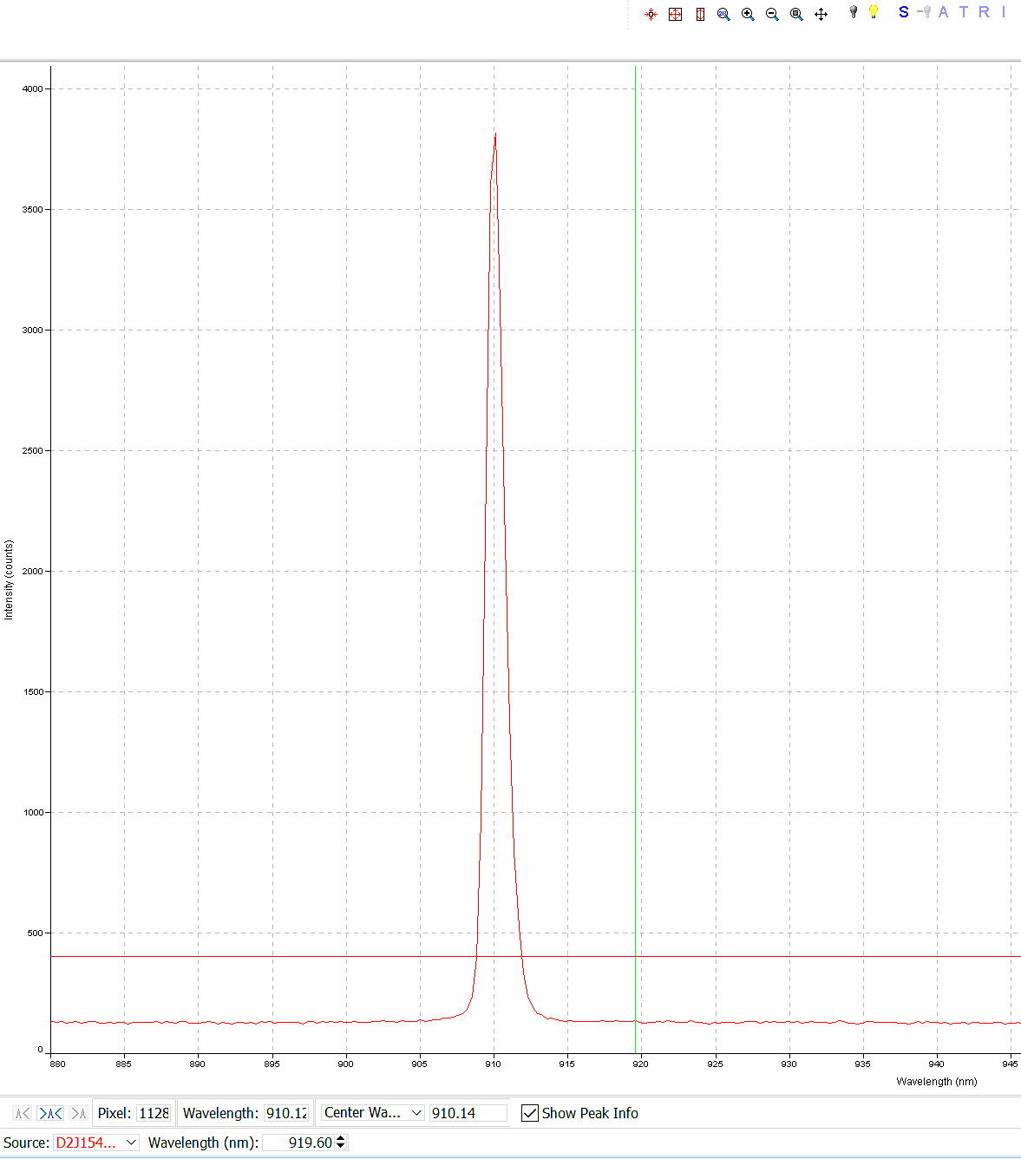
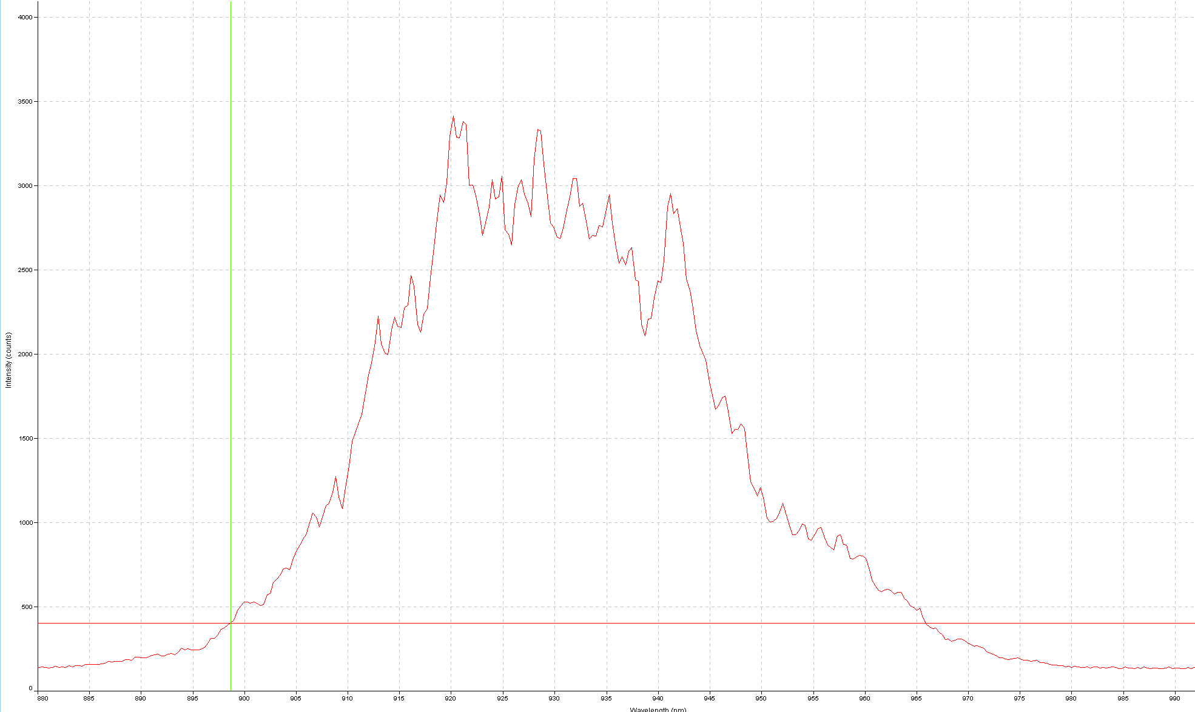
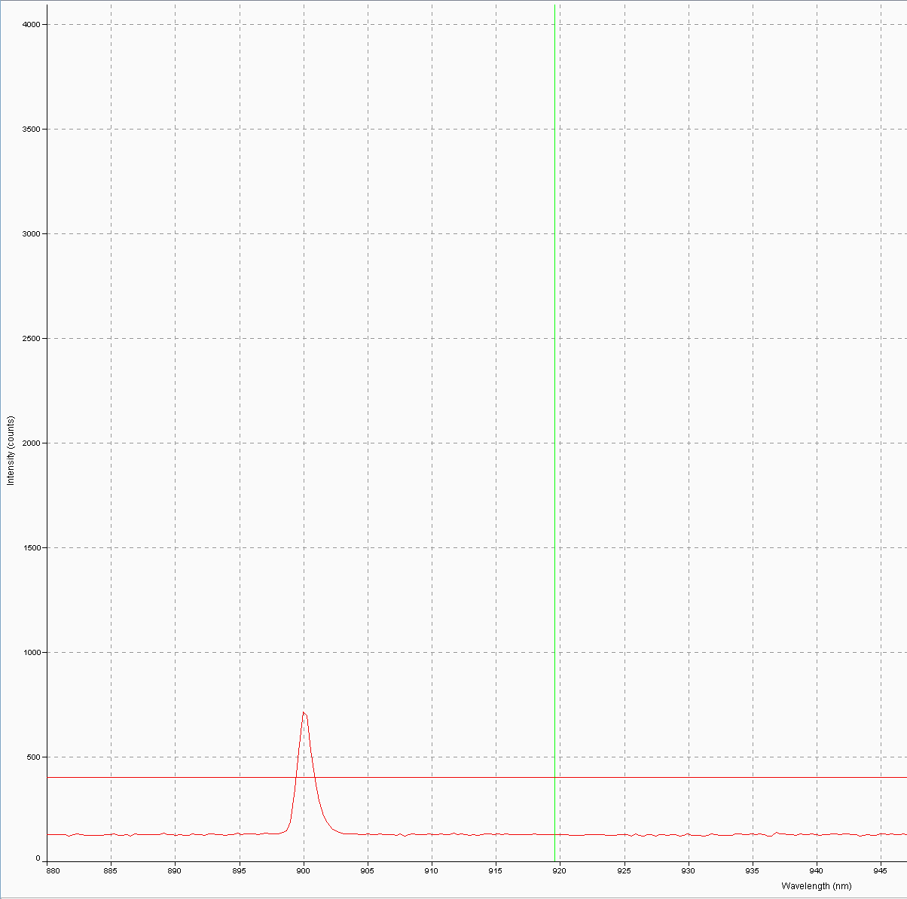
Source spectrum
920 nm
RCBG
910 nm
900 nm
60% of 920
ND Filter
21% of 920 ~ like source
22% of 920
900 nm
910 nm
920 nm

Slide 3
Intensity measured by linear CCD
Blocked
wavelengths
LCD
RCBG
Block the beam with a paper
920 nm
900 nm
910 nm

